Slide 1
Types of Plate Boundary
Unit 1: Topic 1: Restless Earth
1.1. How and why do the Earth’s tectonic plates move?
Lesson Objectives
To be able to describe the identify and name the three main types of plate boundary
To be able to describe the processes that occur at each plate boundary.
To be able to draw a diagram of what happens at each.
To be able to give examples of each.

Slide 2
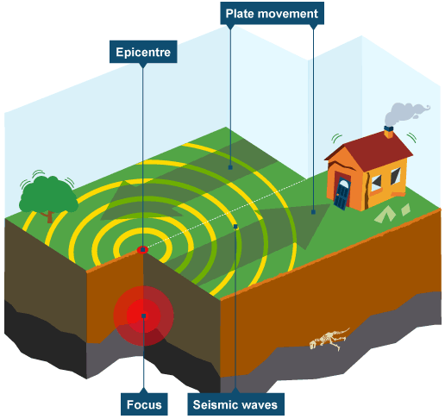
Conservative Plate Boundary
This plate boundary is where two plates are moving past each other in opposite directions, or in the same direction at different speeds. Friction gathers between the places; when the friction becomes too much the plates 'slip' in a sudden movement which causes an earthquake and produces shockwaves.

Slide 3
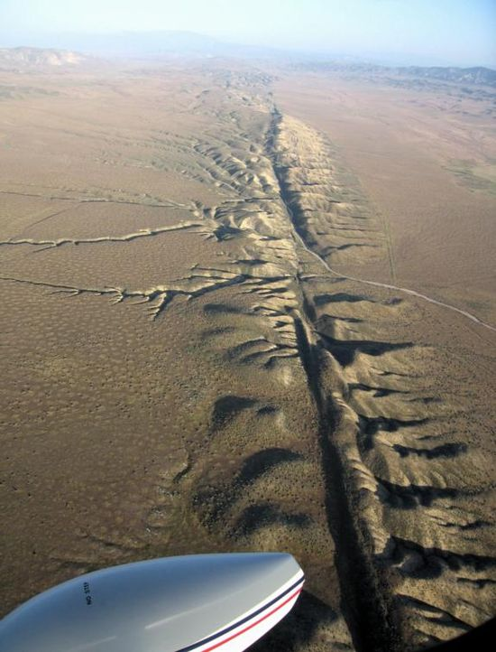
Conservative Plate Boundary
An example of this is the San Andreas Fault in California. Eventually (in a long, long time) Los Angeles will be further north than San Francisco due to being on the side of the fault which is moving northwards. Conservative plate boundaries are sometimes also called a transformative or transform boundary.

Slide 4
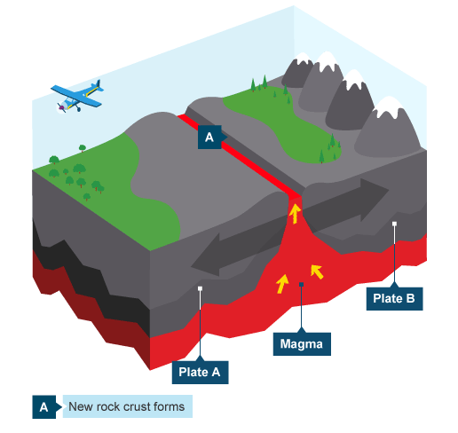
Constructive Plate Boundary
A constructive plate boundary occurs where two plates move apart from each other. Magma moves upwards to fill the gap and solidifies creating volcanoes. This eventually results in new crust being forms.

Slide 5
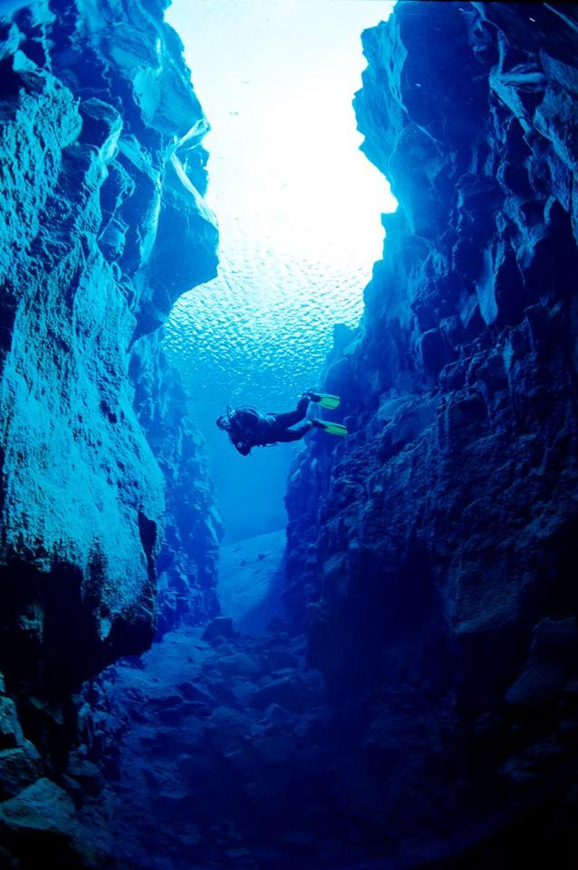
Constructive Plate Boundary
An example of this is the Mid-Atlantic Ridge. The Mid-Atlantic Ridge is part of the longest mountain range in the world. Constructive plate boundaries are sometimes also called divergent plate boundaries.

Slide 6
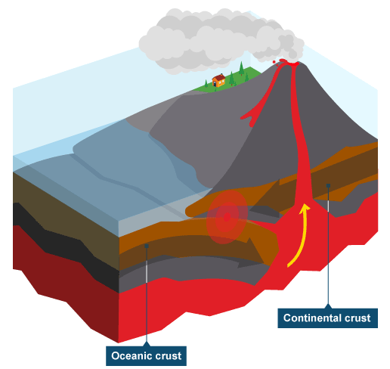
Destructive Plate Boundary – Subduction Zone
This occurs when oceanic and continental (or oceanic and oceanic) plates meet. The denser oceanic plate is forced down underneath the continental place. Heat caused by friction makes the oceanic plate melt. Magma rises up through cracks and erupts at the surface. Earthquakes can also occur in the subduction zone.
An example is the Nazca plate being subducted under the South American Plate.

Slide 7
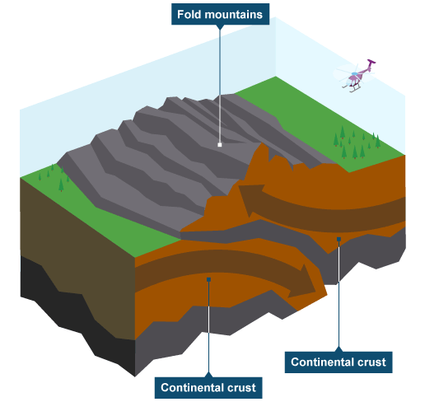
Destructive Plate Boundary – Collision Zone
When two continental plate boundaries meet they form what is known as a collision zone. Both plates are equally dense and thus neither is forced underneath the other. They are therefore both forces up and create fold mountains.

Slide 8
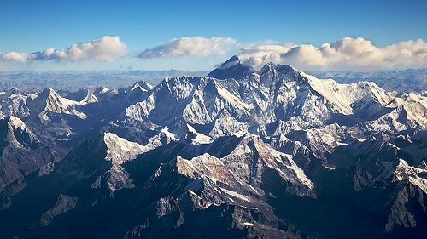
Destructive Plate Boundary – Collision Zone
An example of a collision zone with fold mountains is the Himalayas. Destructive plate boundaries are sometimes also called Convergent Plate Boundaries.

Slide 9
Unit 1: Topic 1: Restless Earth
1.1. How and why do the Earth’s tectonic plates move?
Lesson Recap
Let’s see if we all met the lesson objectives. Hold up your red, orange or green cards in response to these questions.
Can I describe the identify and name the three main types of plate boundary?
Can I describe the processes that occur at each plate boundary?
Can I draw a diagram of what happens at each?
Can I give examples of each?

